Slide 1
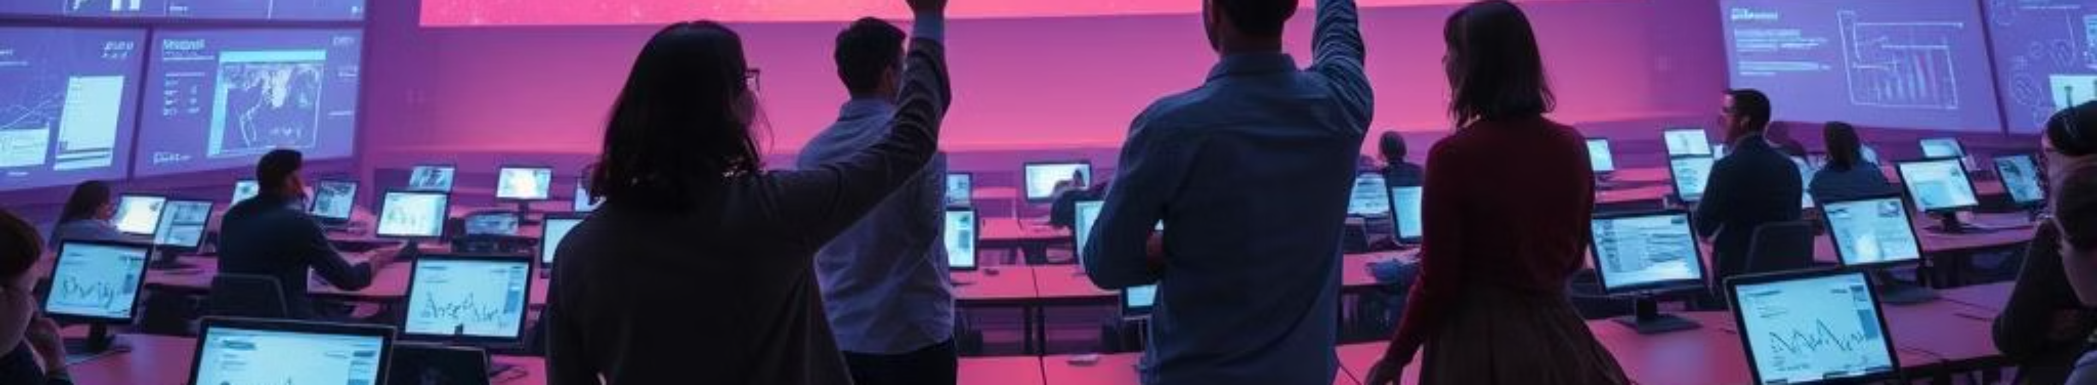
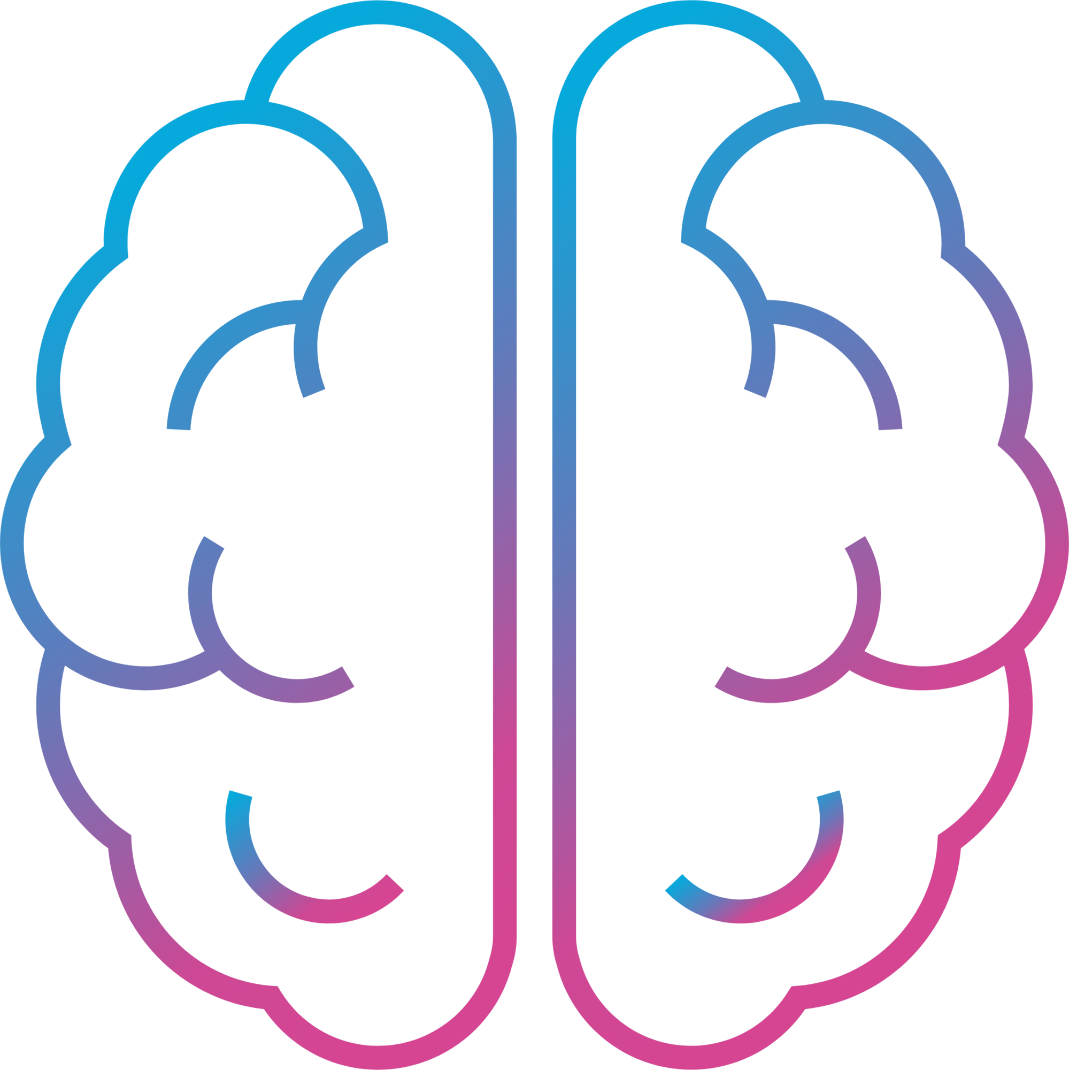
MotionMind
Touchless Control for the Future
The world is moving toward touchless, intelligent interaction. Yet, most systems rely on outdated, unhygienic, and
inaccessible tools like keyboards, mice, and touchscreens.
The Opportunity
Education, presentations, and smart environments need a simpler, more natural way to interact.
Outdated Tools
Hygienic Needs
Accessibility Gaps
Keyboards, mice, and touchscreens are no
longer sufficient.
Demand for touchless solutions is increasing.
Many users face barriers with current interaction
methods.
The Solution
MotionMind is an AI-powered gesture recognition platform. It enables natural hand gesture control of digital systems via a standard webcam,
requiring no special hardware.

Slide 2


Who It’s Built For
Educational Institutions
Corporate Trainers & Presenters
Accessibility Use
Schools, colleges, and universities adopting smart learning.
Hands-free control for seamless training and presentations.
Inclusive interaction for users
with physical limitations.
Smart Classrooms & Innovation Labs
Interactive Learning & Gaming
Engaging, gesture-based educational experiences.
Touchless control in modern, tech-enabled spaces.
Why MotionMind Wins
Zero Hardware Cost
Touchless & Hygienic
Utilizes existing webcams, eliminating extra expenses.
Promotes a cleaner, safer interaction environment.
AI-Powered & Scalable
Easy Deployment
Advanced AI ensures robust performance and adaptability.
Web-based platform for quick and simple integration.
AI • Computer Vision • Human–Computer Interaction

